Slide 1
Weekly Meeting
Nov 22, 2021
Gwangwoo Kim

Slide 2
1.1 Boolean retrieval
Suppose you wanted to determine which plays of Shakespeare contain the words Brutus AND Caesar AND NOT Calpurnia.
One way to do that is to start at the beginning and to read through all the text. The way to avoid linearly scanning the texts for each query is to index the documents in advance.

Slide 3
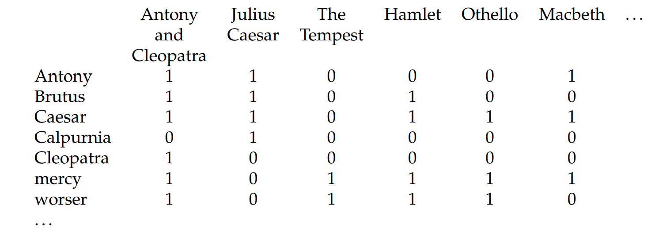
1.1 Boolean retrieval

Slide 4

Brutus AND Caesar AND NOT Calpurnia

Slide 5
1.1 Boolean retrieval
A much better representation is to record only the things that do occur, that is, the 1 positions.
This idea is central to the first major concept in information retrieval, the INVERTED INDEX.

Slide 6
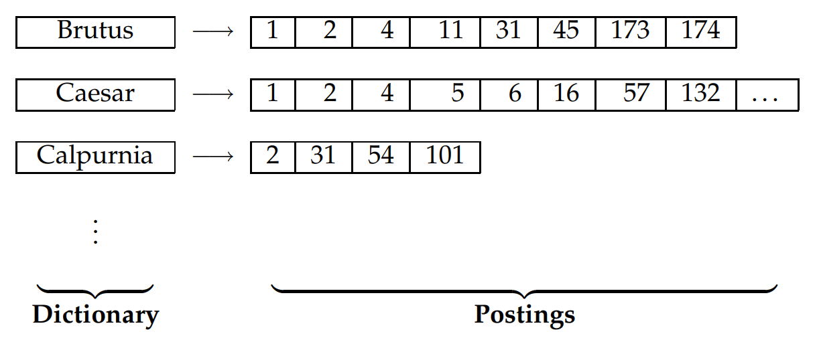
1.1 Boolean retrieval

Slide 7
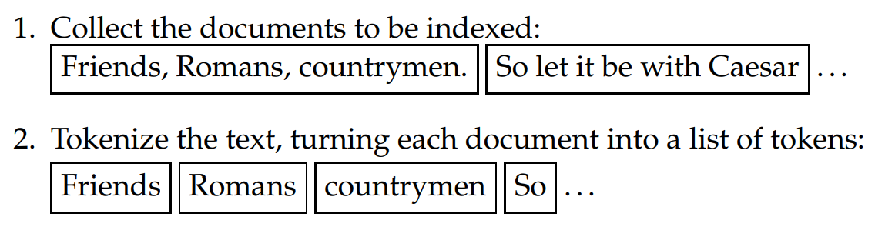
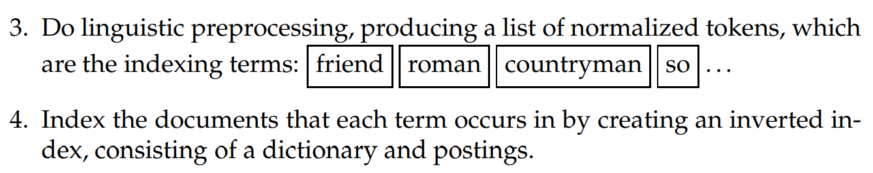
1.2 A first take at building an inverted index

Slide 8
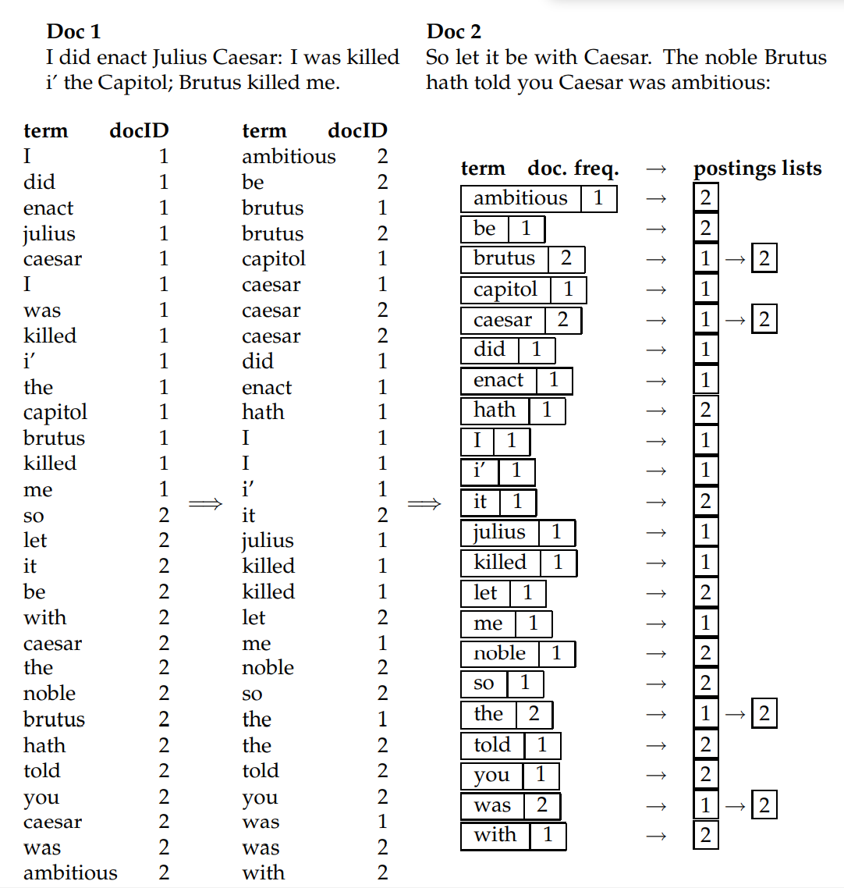
This inverted index structure is essentially without rivals as the most efficient structure for supporting ad hoc text search.

Slide 9
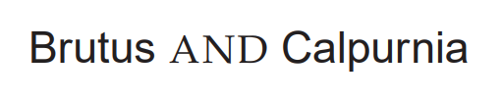
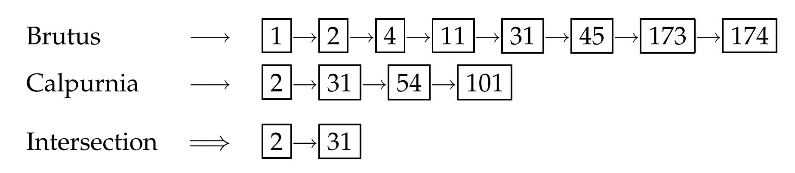
1.3 Processing Boolean queries
Consider processing the simple conjunctive query:

Slide 10
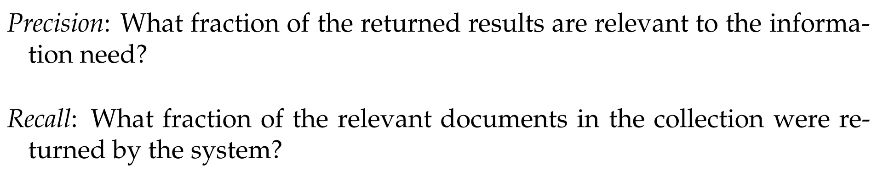
1.3 Processing Boolean queries
A general problem with Boolean search is that using AND operators tends to produce high precision but low recall searches, while using OR operators gives low precision but high recall searches, and it is difficult or impossible to find a satisfactory middle ground.

Slide 11
1.4 The extended Boolean model versus ranked retrieval
Provide retrieval that is tolerant to spelling mistakes and inconsistent choice of words.
It is often useful to search for compounds or phrases that denote a concept such as “operating system”.
We need term frequency information in postings lists.
We wish to have an effective method to order (or “rank”) the returned results.

Slide 12
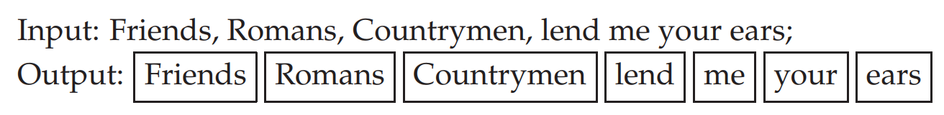
2.2.1 Tokenization
An example of tokenization:

Slide 13
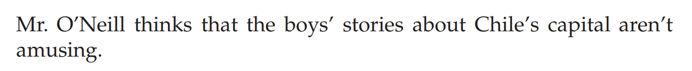
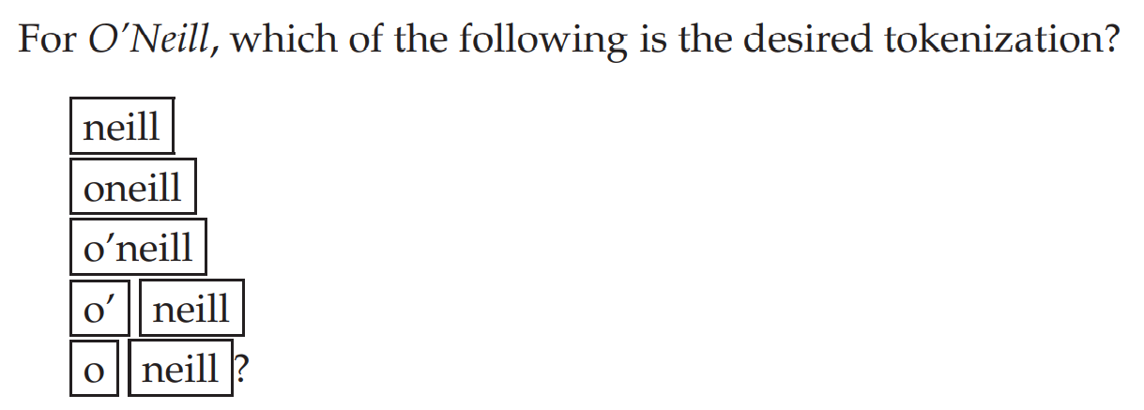
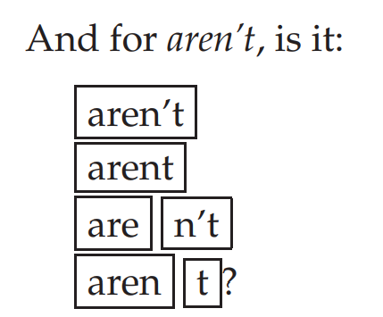
2.2.1 Tokenization
Input:

Slide 14
2.2.1 Tokenization
Input: I am really interested in data science.
(expected) output: ‘I’, ‘am’, ‘really’, ‘interested’, ‘in’, ‘data’, ‘science’
Input: over-eager
(expected) output: 1. over-eager 2. over eager 3. overeager

Slide 15
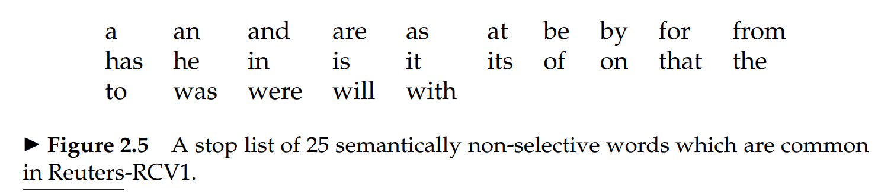
2.2.2 Dropping common terms: stop words

Slide 16
2.2.2 Dropping common terms: stop words
President of the United States
“President” AND “United States”

Slide 17
2.2.2 Dropping common terms: stop words
The general trend in IR systems over time has been from standard use of quite large stop lists (200–300 terms) to very small stop lists (7–12 terms) to no stop list whatsoever.

Slide 18
2.2.3 Normalization (equivalence classing of terms)
USA ~ U.S.A
anti-discriminatory ~ antidiscriminatory
car ~ automobile (?)
window ~ windows
windows ~ Windows (운영체제) (??)
C.A.T. ~ cat (??)
naïve ~ naive
colour ~ color
The best amount of equivalence classing or query expansion to do is a fairly open question.

Slide 19
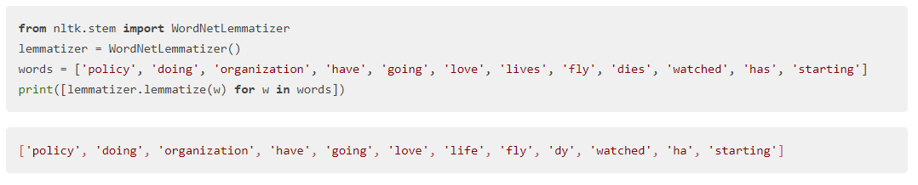
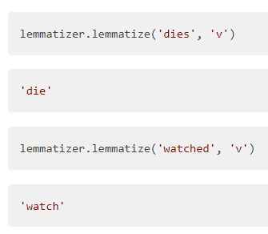
2.2.4 Stemming and lemmatization

Slide 20
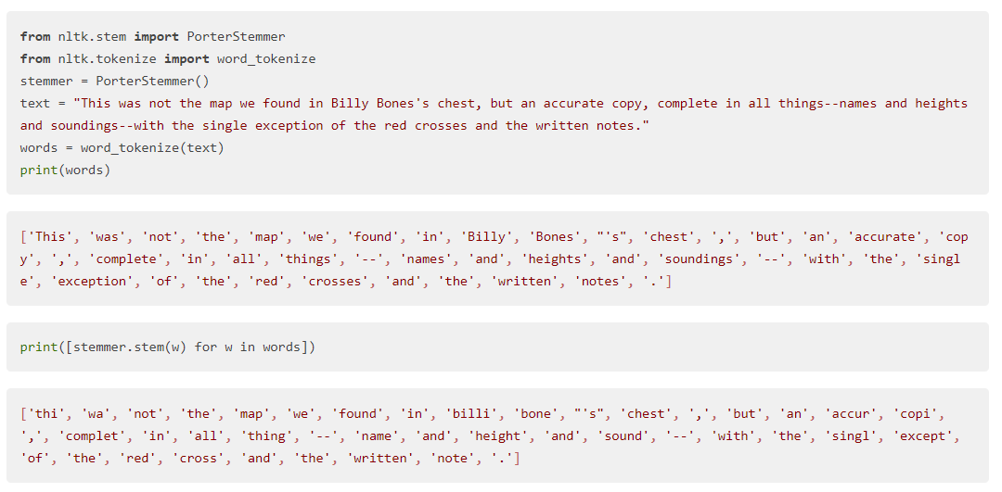
2.2.4 Stemming and lemmatization

Slide 21
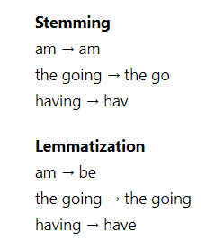
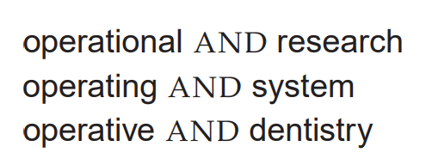
2.2.4 Stemming and lemmatization
oper

Slide 22
2.4.1 Biword indexes
The query stanford university palo alto can be broken into the Boolean query on biwords:
Without examining the documents, we cannot verify that the documents matching the above Boolean query do actually contain the original 4 word phrase.

Slide 23
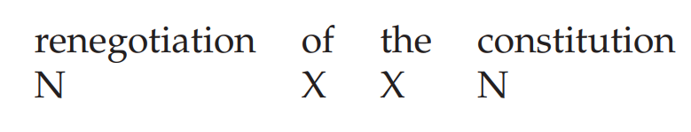
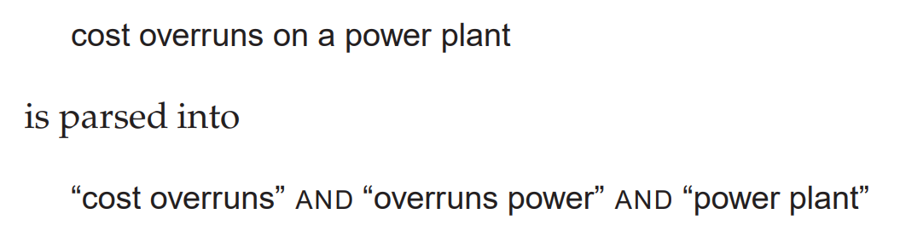
2.4.1 Biword indexes

Slide 24
2.4.2 Positional indexes
Consider the query, “to be or not to be”.
Step 1: Find documents that contain “to” and “be”.
Step 2: Look for places where there is an occurrence of “be” with a token index one higher than a position of “to”.
Step 3: So on until finding the desired result.

